Slide 1
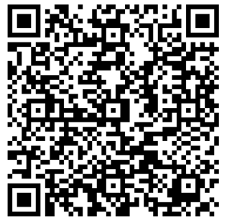
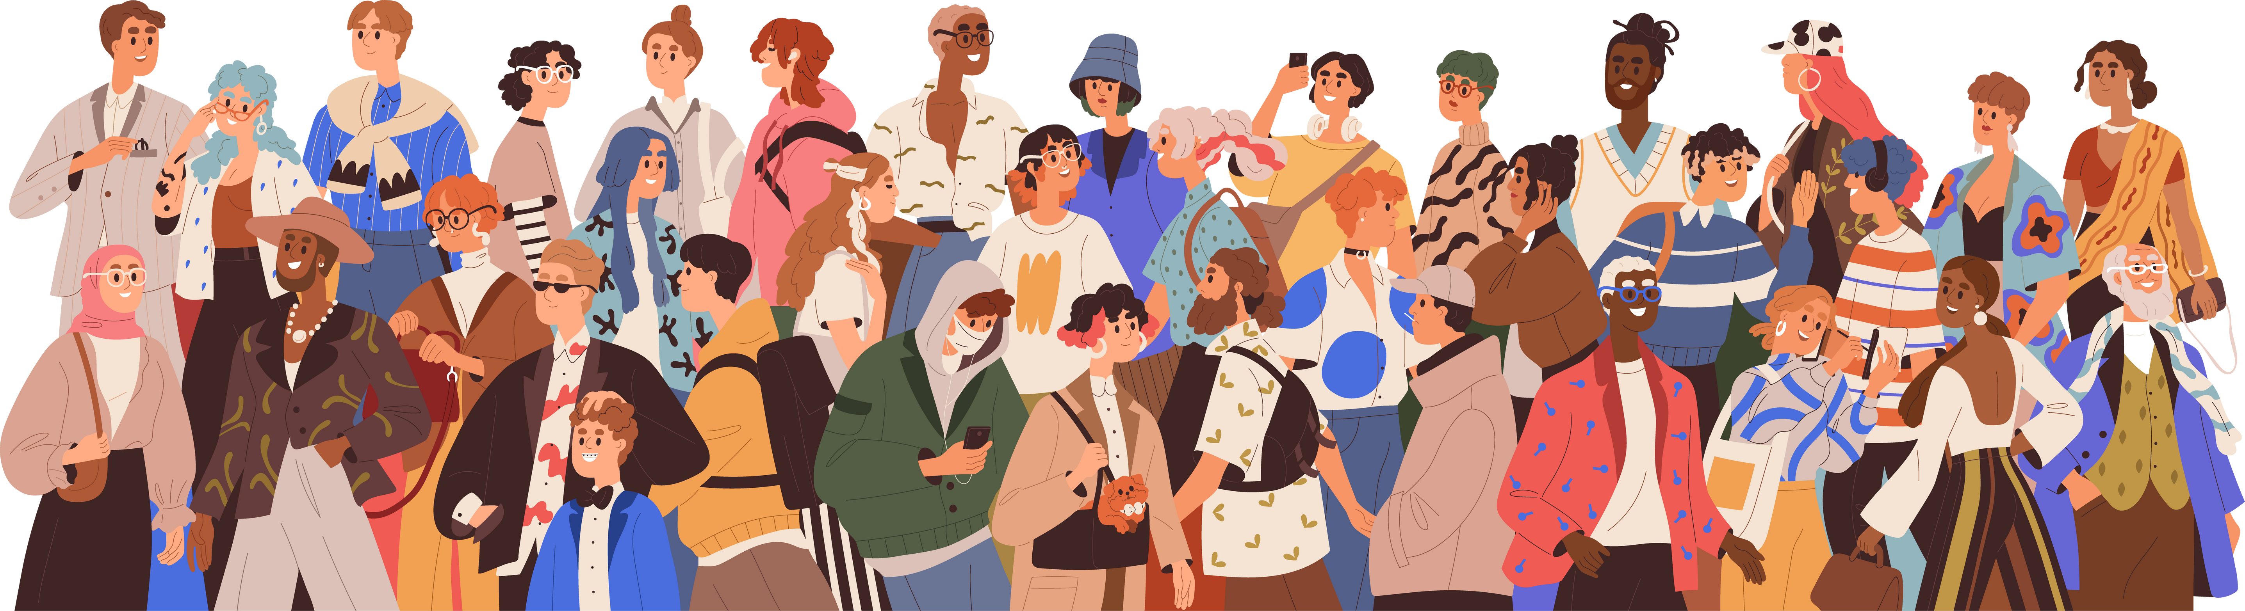

Class of 2027
QR code goes here

Slide 2


Learning Targets
01
02
03
The students should be able to identify the career and college advancement opportunities on Campus and be involved in at least 1
The students should have an academic plan with 7 courses listed (TA and Early release included pending form submission)
The students should be aware of their graduation and A-G status.
IE: Summer school, Credit recovery, Community service

Slide 3



Meet your counselor
Counselors will be calling you out to speak with you and about your post secondary goals, your academic plan, your transcript, your graduation status, and A-G requirements.
David Carrillo | Serves students with the last names that start with A-D
Amanda Pesavento | Serves students with the last names that start with E-Loo
Connie Rho | Serves students with the last names that start with Lop-Re
Kesha Andrews | Serves students with the last names that start with Rf-Z
Lisa Amstutz | Serves students who are enrolled in our AVID program

Slide 4


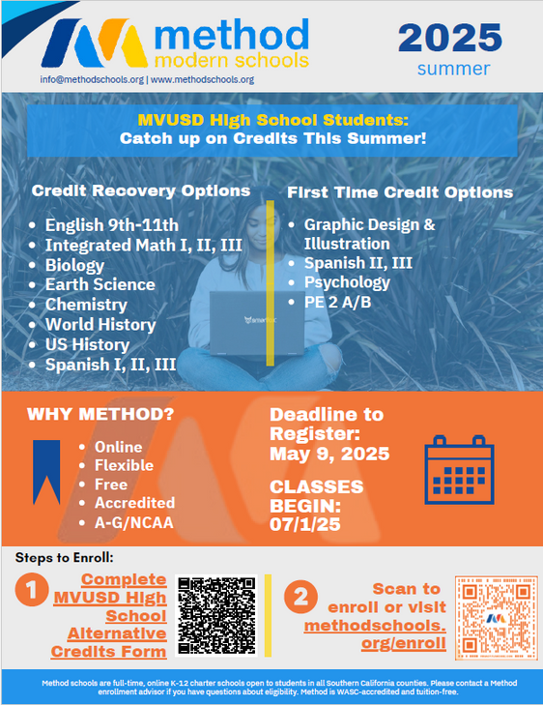

Slide 5

AP/ Dual/ Concurrent enrollment/ Articulation
Advanced Placement (AP)
  Year long college course graded on a 5.0 scale
  Can earn college credit if you pass the AP exam with a (3,4, or 5)
  The level of rigor reflects that of a collegiate level
  You must stay in the AP course for at least 3 weeks and may only drop up to 6 weeks
  Taught by an MVUSD instructor
Dual Enrollment
  Semester long courses with 5 credits on 5.0 scale and 5 credits on a 4.0 scale per semester earning 10 credits through MVUSD per semester.
  Will earn college credits when you pass the course
  Taught by an MVUSD instructor
Concurrent Enrollment
  Semester long courses that earn college credit
  Previous ANNEX courses are only courses approved for MVUSD credit
  Enrollment/ Orientation/ SPA form/ and registration are required
  There are some mandatory fees per semester
  College transcripts are still sent in college applications
Articulation
  An MVUSD course that has an agreement with MSJC
  If you earn an A or a B in the course and pass the final you will earn college credit
  Approved credit exam must be passed with a 70% or higher to earn credit in the form of a P or a letter grade in some circumstances

Slide 6








CTE pathways
Notes:
Pathways can be deleted to match the offerings at your site.

Slide 7




Does this mean free money for college?
Calkids
Up to $1500 for 3.4 Million School-Age Children:
  $500 Automatic Deposit: Eligible low-income public school students in grades 1-12.
  $500 Additional Deposit: Eligible low-income public school students in grades 1-12 identified as foster youth.
  $500 Additional Deposit: Eligible low-income public school students in grades 1-12 identified as homeless.
Claim your account at www.calkids.org
Cal kids program fast facts

Slide 8



CSU direct admissions
Opportunities
Clarification
Resources
10 campus are providing direct admissions for students who are A-G and meet the minimum GPA requirements. This does not apply to impacted majors.
You must apply to be admitted. You may be eligible for 4 application fee waivers if you meet the income requirements and an additional fee waiver may be sent to all students who meet the A-G admission requirements.
Impacted majors by location
CSU Fee Waiver
Supplemental Admission Factors

Slide 9

Postsecondary funding
Free application for federal aid
Scholarships
WebGrants
Cal kids
VA Benefits
Loans (Subsidized and unsubsidized)
Promise program

Slide 10
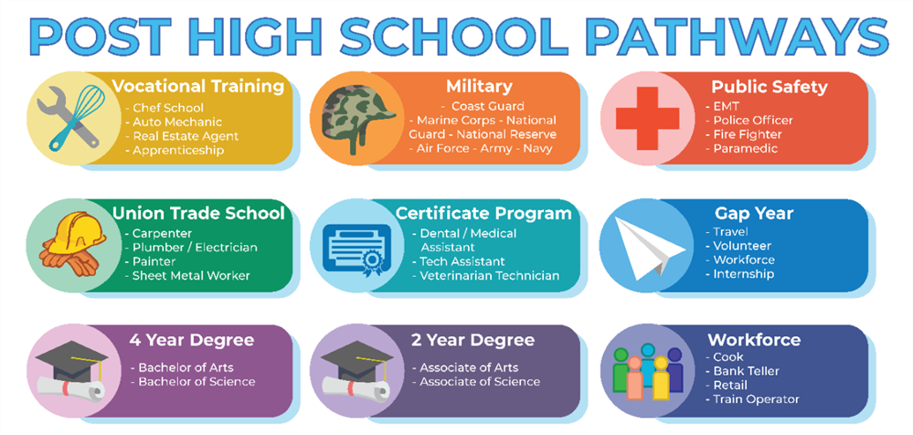


Slide 11

Career search tool
  Login to your California Colleges Account (Californiacolleges.edu)
  Login information
    Username: Your 9-digit ID@MVUSD.org
    Password: Previously created by you
  Click the Career Tab at the top of the page
  Click Career Search Tool (Under Career Options)
  Explore careers that match your interests. Find careers by using the keyword search or the Industry and Bright Outlook filters.
  You must like/heart 3 careers that you are interested in.
  Once you select 3 or more, explore and compare the careers. Also click on the career titles to learn more about that career and the required postsecondary coursework.
Resources for further information and research:
Career videos and training information
https://www.onetonline.org/

Slide 12
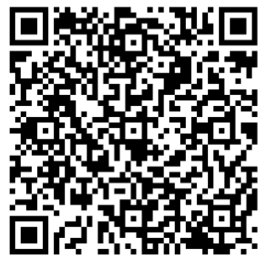
Thank You for listening
QR code goes here

